Slide 1
Advanced CSS Properties
Session 8
(slot 13-14)

Slide 2
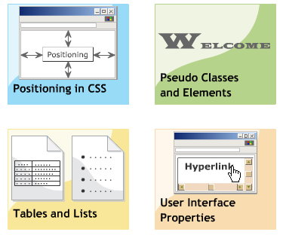
Objectives
Positioning, floating in CSS
Pseudo Classes and Elements
Table and List
User Interface Properties

Slide 3
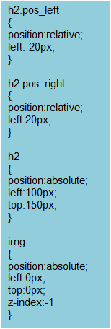
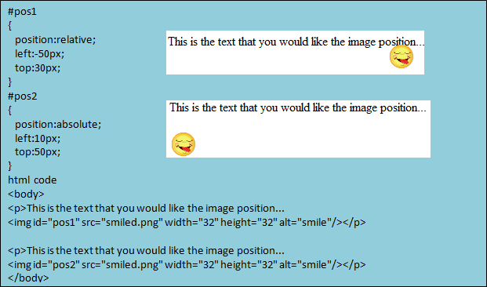
Positioning in CSS - Concepts
The position property in CSS specifies the position of content
There are three types of positioning: normal, absolute, relative
By default, the value of position property is static, the content is displayed the normal flow. The contents of a Web page are placed in the sequence that is specified by the HTML source
Absolute positioning: changes position of element’s content based on the specified co-ordinates. It removes the content from the original flow of content and does not affect the other element in a flow.
Relative positioning: places the content within an element by considering the normal flow. It moves the content with respect to its original flow.

Slide 4
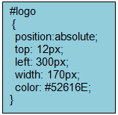
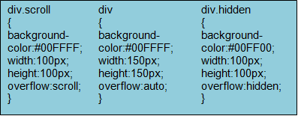
Positioning in CSS - Size and Position Properties
Size: Set dimensions for contents within an element.
There are two size properties in CSS: height, width
Position: Specify the position of the element’s content along the x and y axis .
The content can be placed along the left, right, top, bottom side
Measurement values: cm, mm, in, em, ex, px

Slide 5
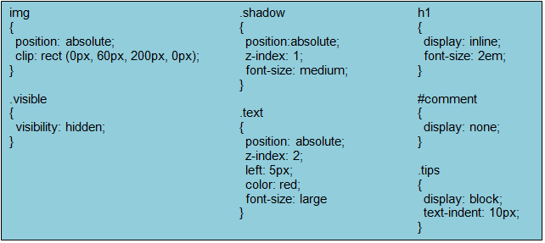
Positioning in CSS - Visibility Properties
Visibility properties specify the way the content appears in an element.
Visibility properties: clip, z-index, visibility, display.

Slide 6
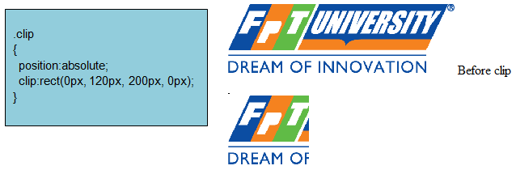
Positioning in CSS - Visibility Properties
The “clip” property specifies the shape of the element’s content that is displayed on the Web page.
It is widely used when the content is too large to fit in the specified space.

Slide 7
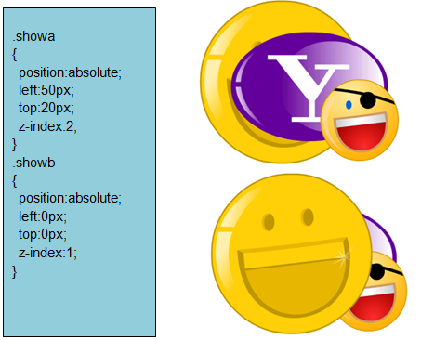
Positioning in CSS - Visibility Properties
The “z-index” property specifies the stack order of an element.
An element with greater stack order is always in front of an element with a lower stack order.
Note: z-index only works on positioned elements (position:absolute/relative/ fixed).

Slide 8
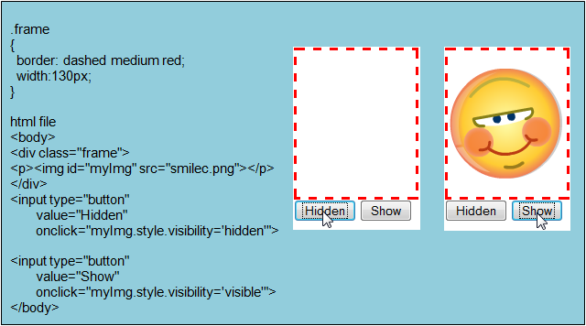
Positioning in CSS - Visibility Properties
The “visibility” property specifies whether or not an element is visible.
The element’s content take up the space on the Web page.

Slide 9
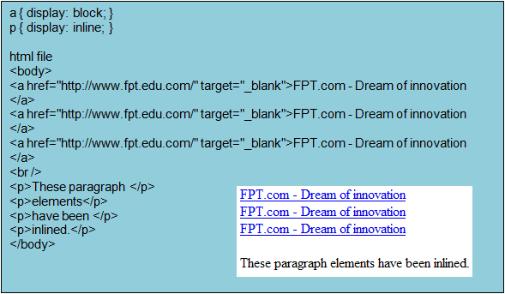
Positioning in CSS - Visibility Properties
The “display” property specifies the way the content is displayed.
It specifies whether the content would contain the line-break or not.
Display vs. Visibility

Slide 10
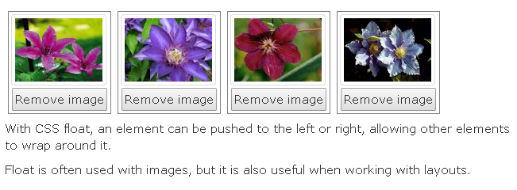
CSS Float

Slide 11
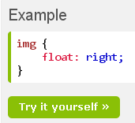
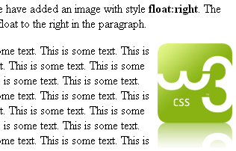
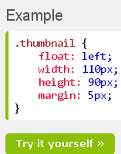
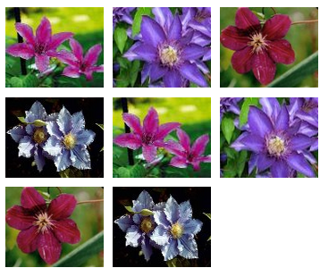
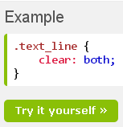

CSS Float
an image is floated to the right
Floating Elements Next to Each Other

Slide 12
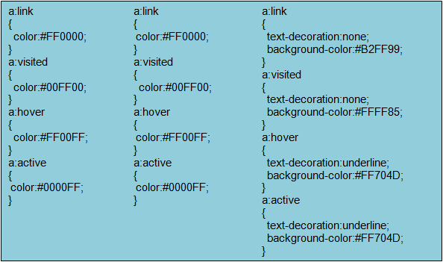
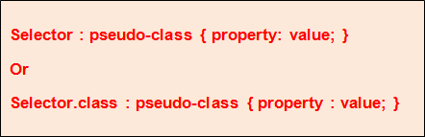
Pseudo Classes and Elements - Pseudo Classes
Pseudo classes allow apply different styles to elements such as button, hyperlinks and so on.
The syntax of pseudo classes:
Where:
Selector: is an element name
Pseudo-class: is one of the states of element: active, hover, link, visited.
Property: in any CSS property such as color, border, font, …

Slide 13
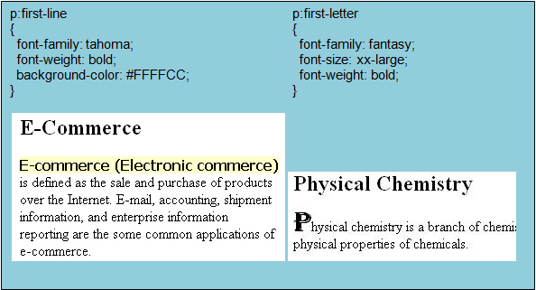
Pseudo Classes and Elements - Pseudo Elements
CSS pseudo elements are used to add special effects to some selectors.
The syntax of pseudo elements: similar to pseudo classes.
The “first-line” pseudo element is used to add a special style to first line of a paragraph.
The “first-letter” pseudo element is used to add a special style to first letter of a paragraph

Slide 14
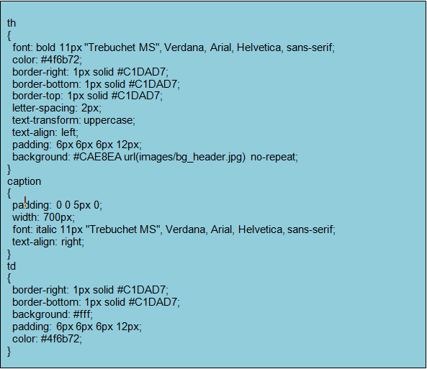
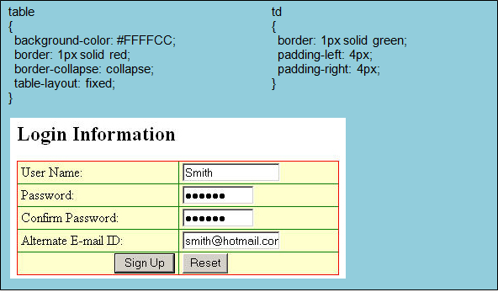
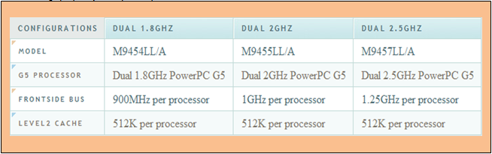
Table and List - Table Properties
Table properties specify the structure and presentation of a table

Slide 15
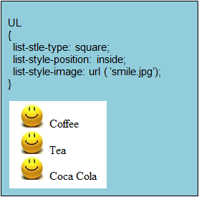
Table and List - List Properties
List properties allow set the type of the list-item marker, apply image to the marker and position the marker

Slide 16
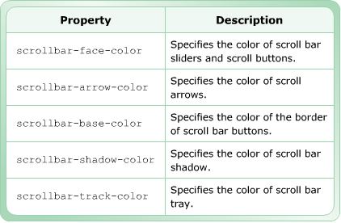
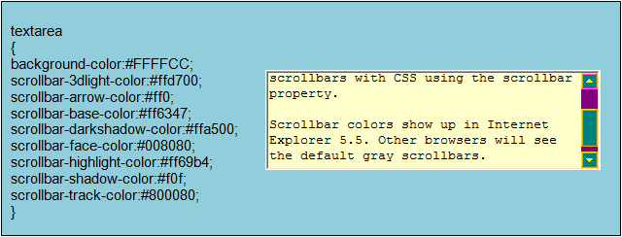
User Interface Properties - Scrollbar Properties
Scroll bars allow the browser window to display continuous text.
CSS allows customize the appearance of the scrollbar by using different scrollbar properties.
The scrollbar properties are not part of the CSS 2.0 specification but these are supported by IE 5.5 or higher versions.

Slide 17
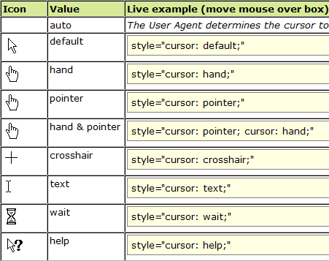
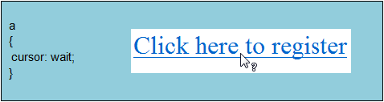
User Interface Properties - Screen Properties
The cursor property: specifies the type of cursor to be displayed when the mouse pointer is placed over the content
Values of the cursor property:

Slide 18
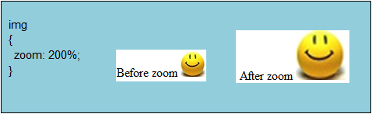
User Interface Properties - Screen Properties
The zoom property: is used to enlarge the contents displayed on the Web page

Slide 19
Summary
Explain the positioning concept in CSS.
Describe the size, position, visibility properties.
Explain the pseudo classes and elements.
Explain the table and list properties.
Explain the scrollbar and screen properties.

Slide 20
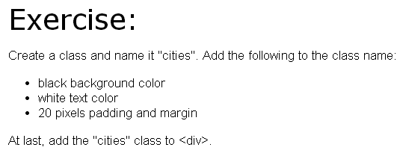
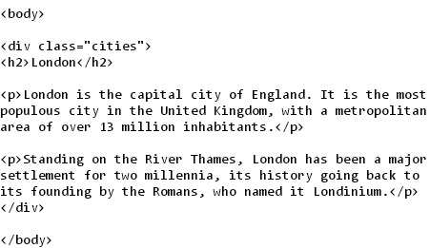

Slide 21

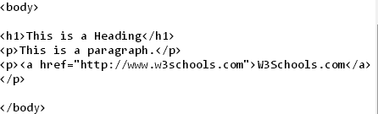

Slide 22
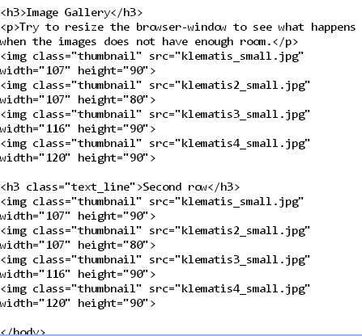
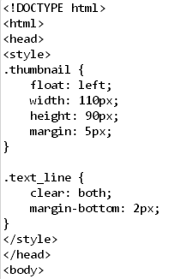
exercise

